Slide 1

SIRV-Based High-Resolution PolSAR Image Speckle Suppression via Dual-Domain Filtering
IGARSS 2019
Yexian Ren, Lingli Zhao , Jie Yang, Pingxiang Li, Lei Shi
E-mail：renyexian@foxmail.com
work done at
Wuhan University

Slide 2
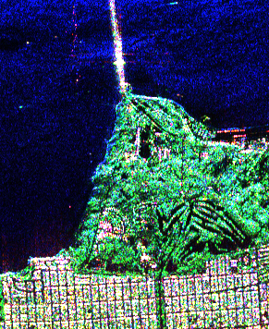
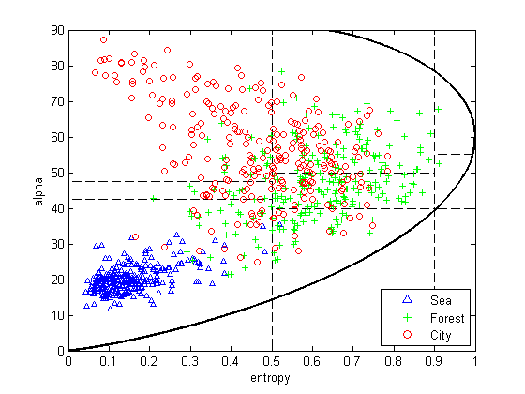
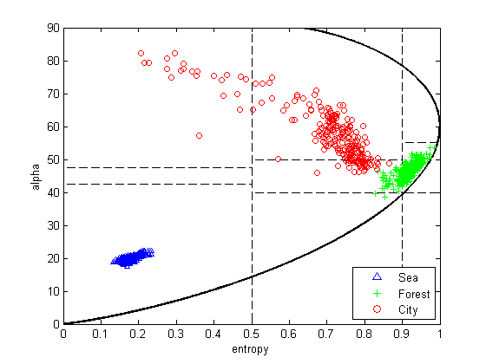
PolSAR Speckle Filtering
Speckle Suppression
An important topic in SAR image processing
estimating physical/polarization parameters; image segmentation; target detection; classification and terrain interpretation
Random fluctuation of speckle leads to centroid aliasing of different scattering mechanisms
AIRSAR L-band
San Francisco
Original 4-look PolSAR image
After 7*7 Refined Lee filter

Slide 3
Previous Works
PolSAR speckle filter (TGRS 2010~2017)
SDAN (IDAN+SIRV), [Vasile et al. 2010]
Nonlocal pretest (Wishart-based) , [Chen et al. 2011]
Nonlocal pretest + Lee, [Zhong et al. 2014]
Generalized meanshift (meanshift+sigma+LMMSE), [Lang et al. 2014]
Adaptive size window + Lee (homogenous index), [Lang et al. 2015]
NL-SAR (Nonlocal + Wishart Kernel + LMMSE), [Deledalle et al. 2015]
Extended Sigma (Rayleigh-based), [Lee et al. 2015]
ACM (boxcar+SIRV+local heterogeneity coefficients), [Yang et al. 2016]
POSSC (patch ordering+simultaneous sparse coding), [Xu et al. 2016]
GMM + Nonlocal, [Wang et al. 2017]
5/10 specifically discussed the heterogeneity and high-resolution PolSAR images.

Slide 4
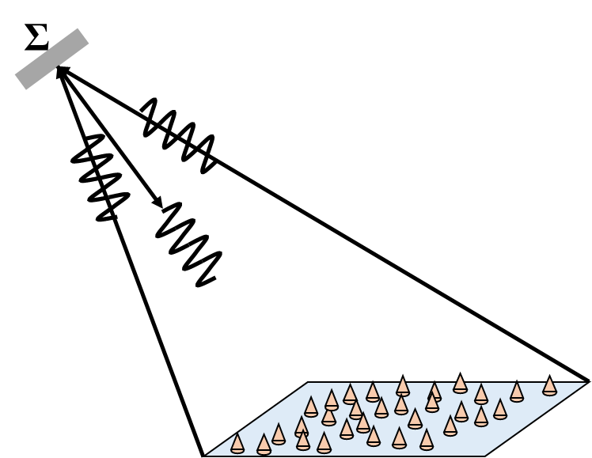
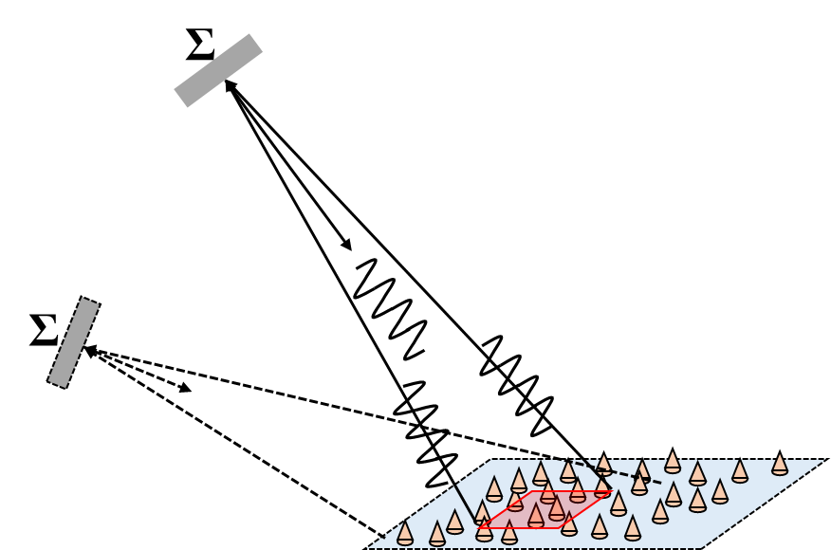
Resolution: Medium/low VS High
Heterogeneous regions in high resolution images
High resolution inevitably leads to heterogeneous clutter
Larger resolution unit
(sufficient elementary scatterers)
Smaller resolution units
(elementary scatterers is not sufficient)
Low grazing angle + narrow-beam
(non-stationary reflectivity)
Central limit theorem，CLT;
Gaussian model is used to model the echo (Complex Vectors).
The amplitude obeys Rayleigh distribution and the multilook coherency matrix obeys Wishart distribution.
Heterogeneous clutter

Slide 5

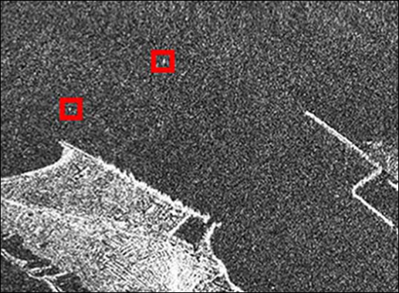
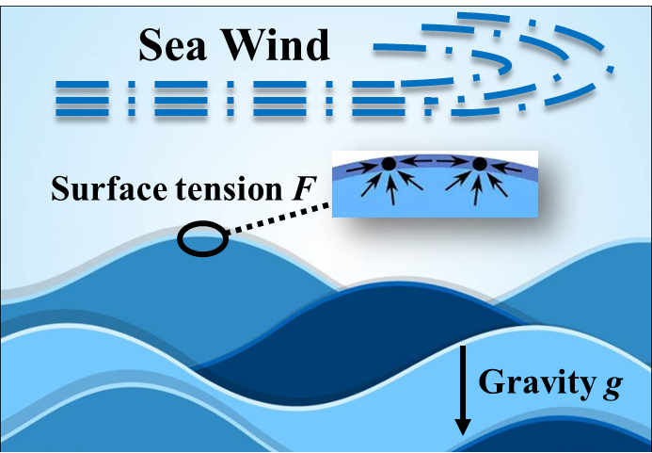
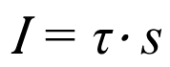
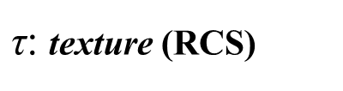
An Interesting Viewpoint about Heterogeneous Sea Clutter
$$\text{I}\text{ = }\text{τ}\text{⋅ }\text{s}$$
$\text{τ}$: texture (RCS)
s: speckle
Viewpoint：Sea surface waves can be decomposed into surface tension waves with micro scale and gravity waves with macro scale.
Tension wave results in fast-changing characteristics of clutter (millisecond order), i.e. speckle component.
Gravity wave results in slow-changing characteristics of clutter (second order), i. e. texture component (modulation component).
Heterogeneous sea clutter can be regarded as the result of amplitude modulation of tension wave by gravity wave.
Notes:
The explanation of the sea clutter decomposition inspired me to do this work.

Slide 6
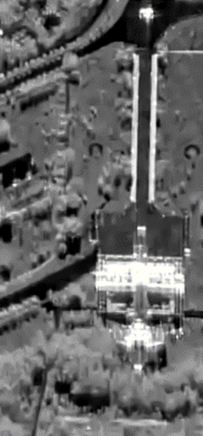
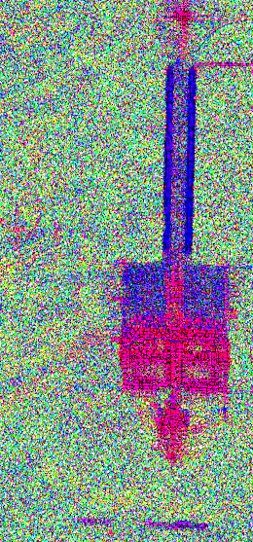


Understanding of High-resolution PolSAR Image
Clutter Decomposition Diagram
The high-resolution PolSAR image can be regarded as the result of amplitude modulation of the fast-changing Gaussian random speckle (contains polarization information) by the slow-changing texture (RCS).
$$=$$
$$×$$
Complex Vectors
texture (RCS)
speckle (polarimetric infomation)
Gaussian random speckle (Three dimensional normalized complex coherency matrix)
Coherent superposition of many random scatterers in micro scale.
Texture (One dimensional nonnegative scalar)
RCS change in macro scale

Slide 7
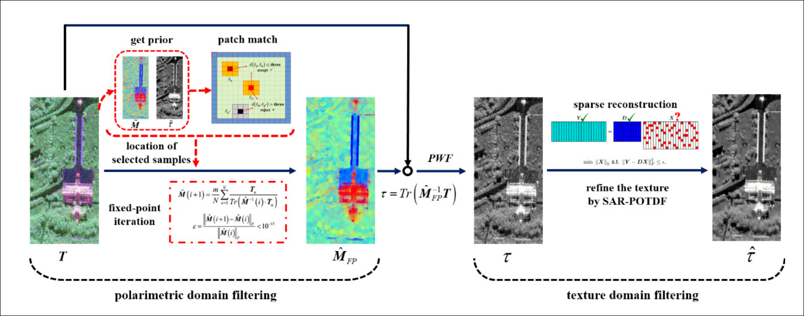
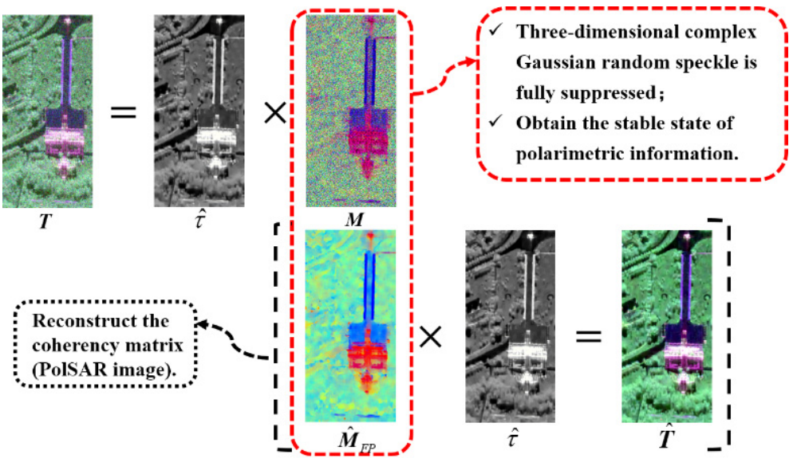
PolSAR Clutter Decomposition and Dual-domain Filter
Inspired by the viewpoint of the SIRV model, a dual-domain filter is designed, which takes full advantage of the clutter decomposition to decompose the task of PolSAR speckle suppression into polarimetric domain filtering and texture domain filtering.
After filtering in polarimetric domain and texture domain, the normalized coherency matrix is re-modulated by reconstructed texture.

Slide 8
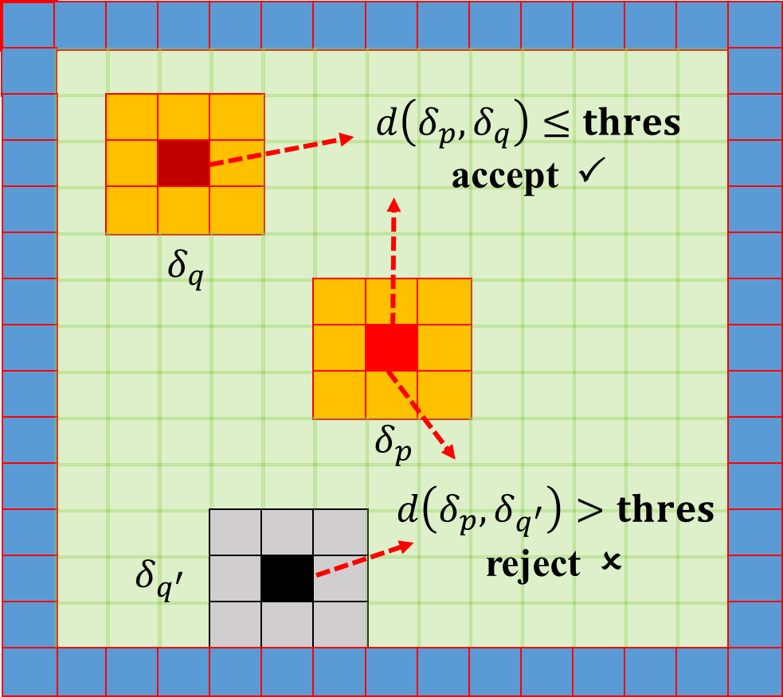
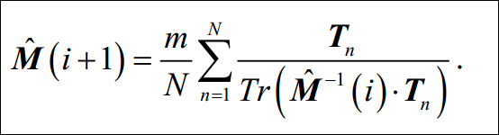
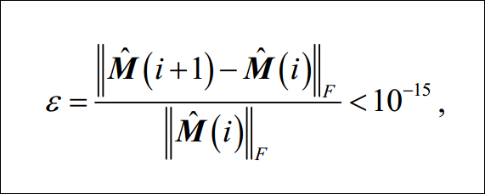
Details of Dual-domain Filter
Polarimetric Domain Filtering
polarimetric and texture prior
Pre-estimation
Patch match
location of selected samples
fixed-point iteration
T is often a single-look coherency matrix format.

Slide 9
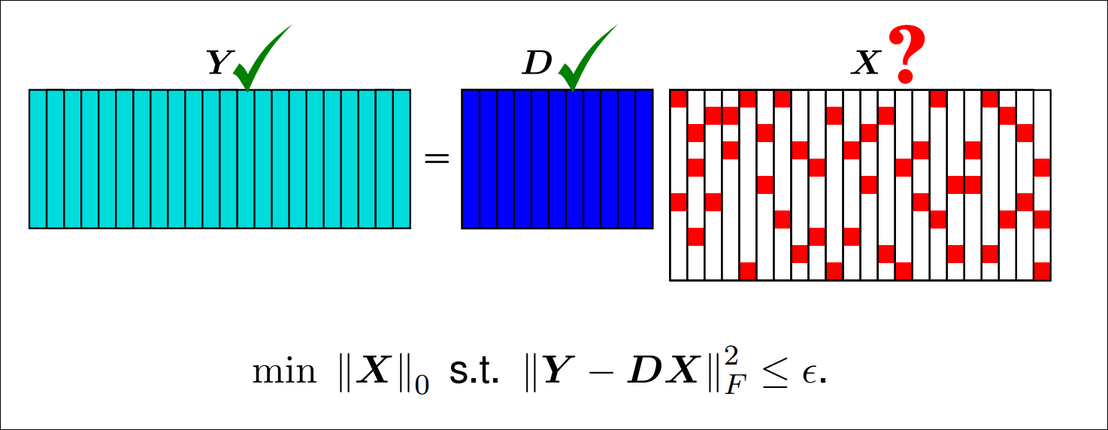
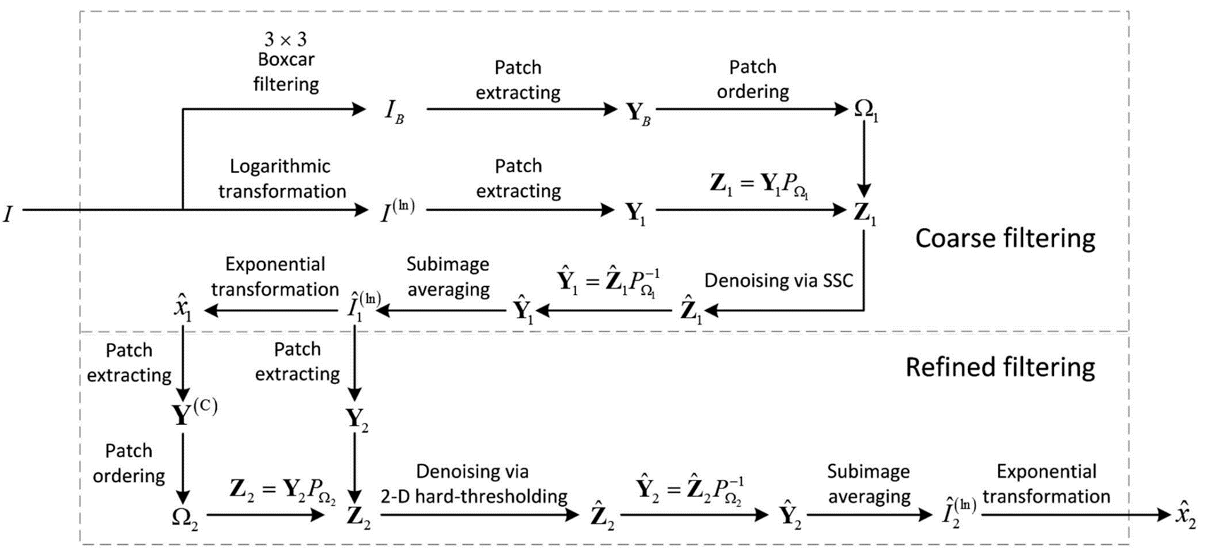
Details of Dual-domain Filter
Texture domain filtering
Sparse reconstruction
PWF
Refine the texture by
SAR-POTDF
SAR-POTDF: B. Xu et al. "Patch Ordering based SAR Image Despeckling via Transform-Domain Filtering" IEEE J. Sel. Topics Appl. Earth Observ. Remote Sens., vol. 8, no. 4, pp. 1682–1695, Apr. 2015.
Readers are also encouraged to use some more recent single-channel SAR despeckling methods for texture domain filtering to further improve the result of texture reconstruction.

Slide 10
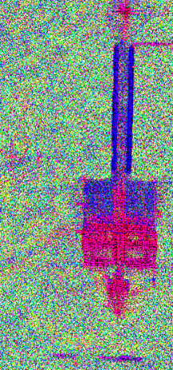




Details of Dual-domain Filter
High-resolution PolSAR image reconstruction
Three-dimensional complex Gauss random speckle is suppressed sufficiently;
The stable state of polarization information is obtained.
$$=$$
$$×$$
M
The polarimetric coherency matrix is amplitude modulated by texture information.
$$×$$
$$=$$

Slide 11
CETC-38 X Band PolSAR Data, Hainan Lingshui

Slide 13
Normalized Coherency Matrix
SIRV estimator result
Dual-domain filter result

Slide 14
CETC-38 X band PolSAR Data, Hainan Lingshui

Slide 15
CETC-38 X Band PolSAR Data, Hainan Lingshui
The experimental results on the single-look PolSAR data is excellent.
Even when dealing with complex scenarios, it is still robust.

Slide 16
DLR FSAR S Band PolSAR Data, Kaufbeuren

Slide 18
IECAS C Band PolSAR Data, Hebei Zunhua

Slide 19
DLR ESAR L band, Oberpfaffenhofen

Slide 20
GaoFen-3 C-band PolSAR Data, Xi’An
Single Look Complex

Slide 21
GaoFen-3 C-band PolSAR Data, Xi’An
Filtering Result

Slide 22
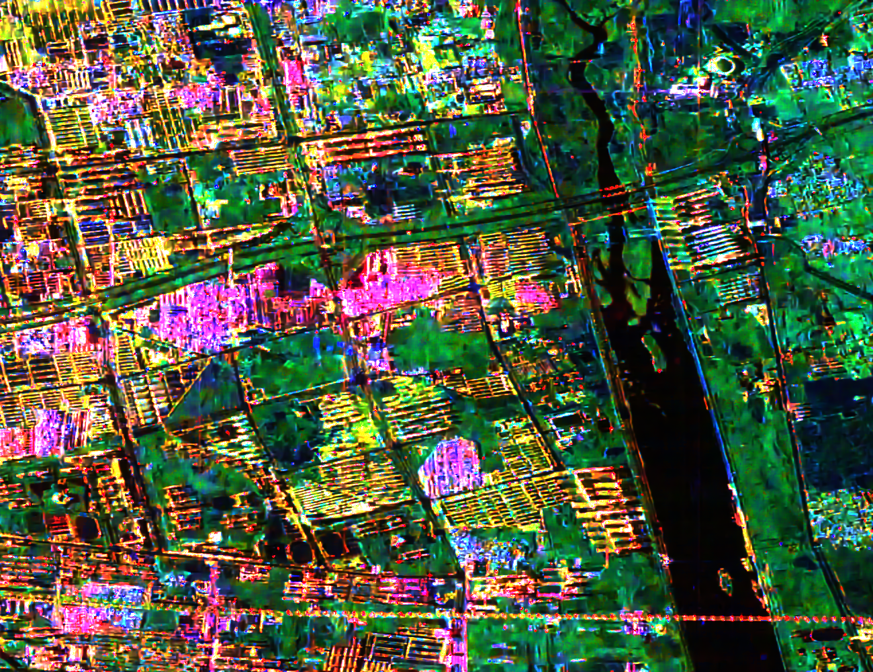

Dual-domain filter + Improved FDD3

Slide 23
GF3 Sea scene reconstruction: ships and waves (using dual-domain filter)

Slide 24
Comparisons
Improved Sigma
Nonlocal pretest
Mean shift
Dual-domain

Slide 25
Improved Sigma
Nonlocal pretest
Mean shift
Dual-domain

Slide 26
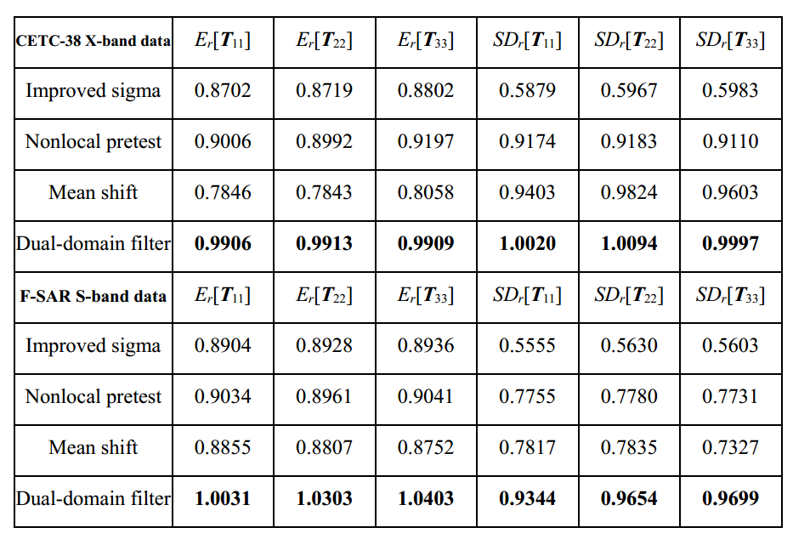

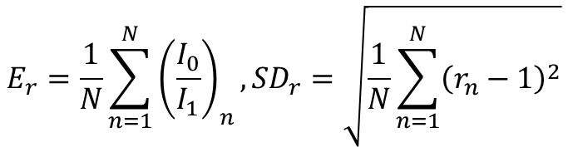
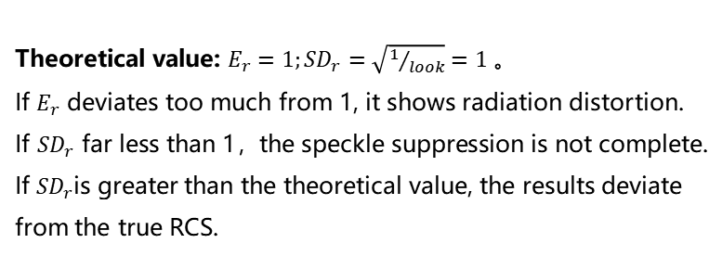
Separated Multiplicative Noise (Ratio)
$$E_{r}=\frac{1}{N}\sum_{n=1}^{N}{{\left(\frac{I_{0}}{I_{1}}\right)}_{n}},{SD}_{r}=\sqrt{\frac{1}{N}\sum_{n=1}^{N}{{\left(r_{n}−1\right)}^{2}}}$$
Theoretical value: $E_{r}=1;{SD}_{r}=\sqrt{1/{look}}=1$。
If $E_{r}$ deviates too much from 1, it shows radiation distortion.
If ${SD}_{r}$ far less than 1，the speckle suppression is not complete.
If ${SD}_{r}$is greater than the theoretical value, the results deviate from the true RCS.
Calculate on 1000$\text{×}$800 single-look PolSAR image

Slide 27
ENL in homogenous region: From 1 to 100
ENL of the original single-look PolSAR image
ENL of the filtered PolSAR image

Slide 28
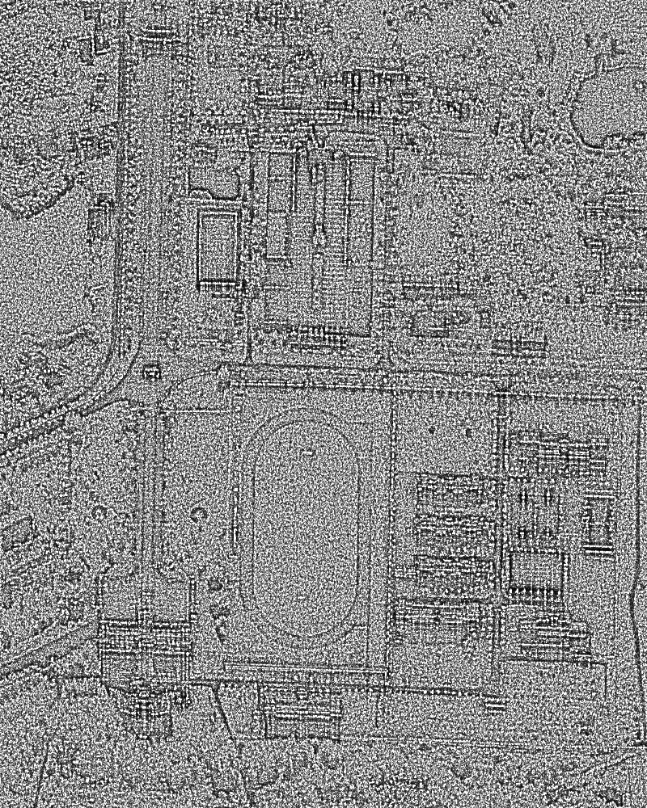
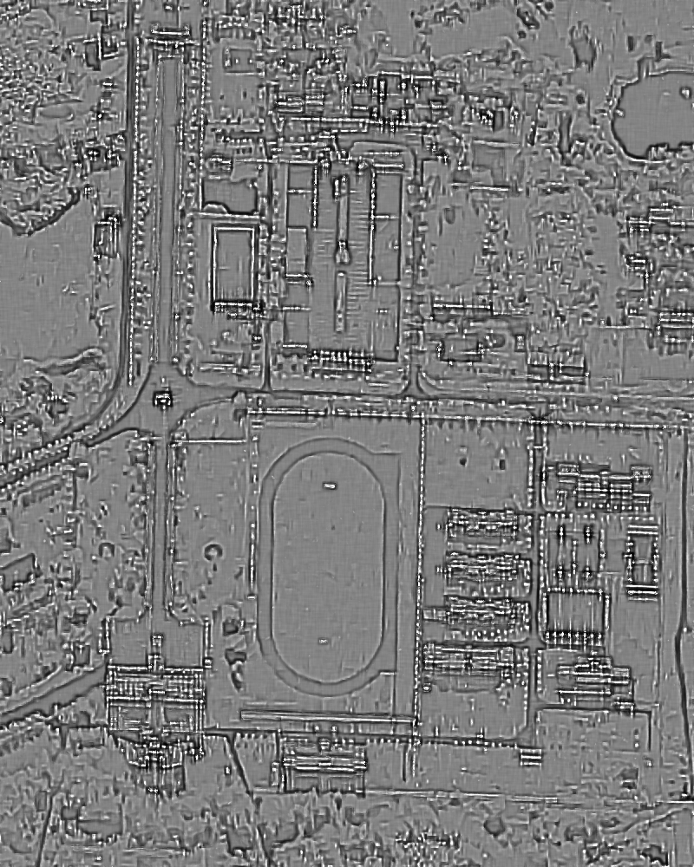
Polarimetric Whitening Filter Processing
Structural information extracted from the original image
(including a lot of natural clutter in homogenous region)
… the dual-domain filtered image
(almost no natural clutter in homogenous region)

Slide 29
Polarimetric Entropy
81-look
dual-domain filter

Slide 30
H/Alpha/A

Slide 31
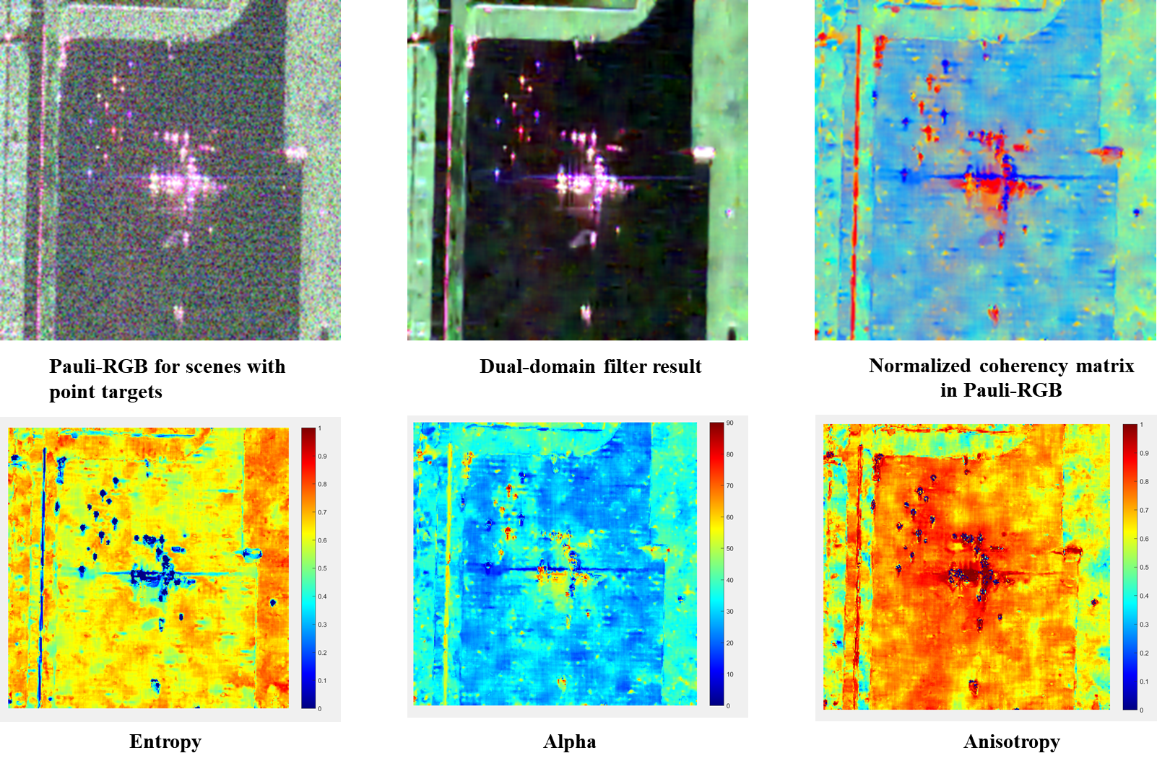
Point Targets Preservation

Slide 32
Effect on the PolSAR Data Classification
AIRSAR L flevoland PolSAR data
PolSAR dual-domain filter result

Slide 33
Effect on the PolSAR Data Classification
Groundtruth;
150 pixels in each class are randomly selected as training samples.

Slide 34
Dual-domain filter + Random Forest Classifier
Correct Rate: 0.9822
Kappa index: 0.9795
The nine channels of the dual-domain filtered coherency matrix are directly input into the random forest without any feature extraction.
If some feature extraction methods are applied, the classification result will be further improved.

Slide 35
Boxcar 5*5 + Random Forest Classifier
Correct Rate: 0.9225
Kappa index: 0.9112
The nine channels of the dual-domain filtered coherency matrix are directly input into the random forest without any feature extraction.
If some feature extraction methods are applied, the classification result will be further improved.

Slide 36
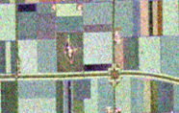
Comparison of Classification Details
Clear
Dual-domain Filter+classifer
Pauli-RGB block of original PolSAR data
Blur
Boxcar 5*5+classifer

Slide 37
AIRSAR L flevoland PolSAR data
Dual-domain filter result

Slide 38
dual-domain filter + RF classifer
Boxcar5*5 + RF classifer
Correct Rate:0.9696; Kappa Index: 0.9640
Correct Rate:0.9485; Kappa Index: 0.9392

Slide 39
EMISAR L foulum PolSAR data
PolSAR dual-domain filter result

Slide 40
dual-domain filter + RF classifer
boxcar filter 5*5 + RF classifer
Correct Rate:0.9157; Kappa Index: 0.8901
Correct Rate:0.8701; Kappa Index: 0.8329

Slide 41
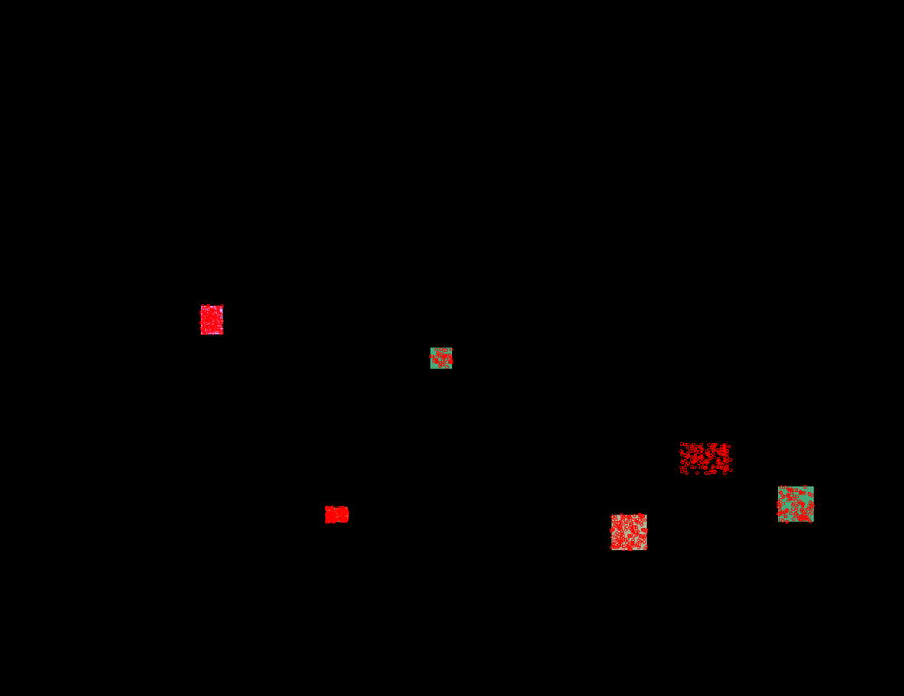
GaoFen-3 PolSAR Classification, Xi’An
The scene is divided into five classes.
150 pixels in each class are randomly selected as training samples.
The nine channels of the dual-domain filtered coherency matrix are directly input into the random forest without any feature extraction.

Slide 42
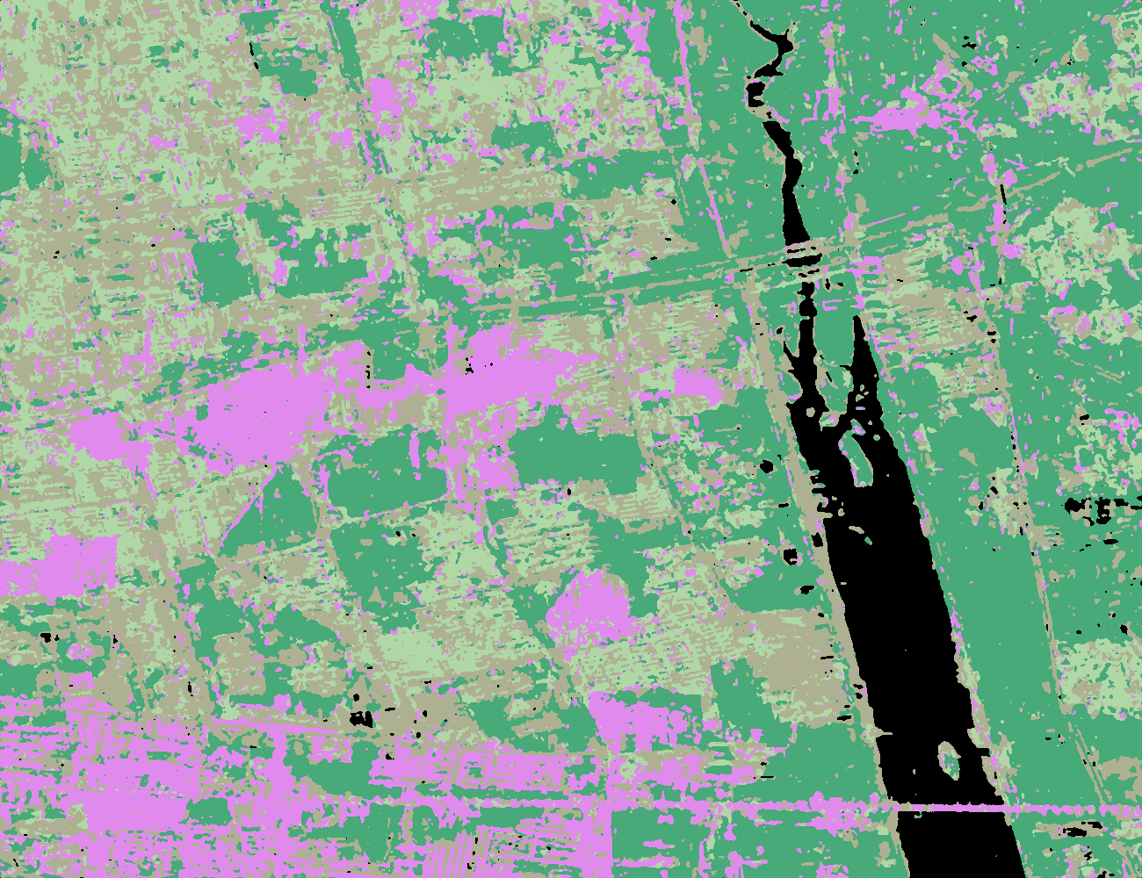
GF3, Xi’An Classification Result

Slide 43
Limitations
The computational load of the dual domain filter is very large.
Basic assumptions of SIRV: All polarization channels share the same texture.
P-band high-resolution PolSAR radar has strong penetration. When H-polarized and V-polarized electromagnetic waves penetrate some objects, their attenuation rates are different. The different textures may be observed in different polarization modes .

Slide 44
IECAS P Band PolSAR Data, Hebei Zunhua
The dual-domain filter may fail when SIRV model and PWF are physically invalid.
The experimental result shows that the dual-domain filter is still effective for speckle suppression, but it may lead to blur when dealing with some distributed targets.

Slide 45
When there is ambiguity on the PolSAR image
FSAR X band
Original data
Dual-domain filter result
Dual-domain filter is difficult to deal with the ambiguity of the image itself.

Slide 46
Changjiang Bridge in Wuhan (GaoFen-3)
Origin
After filtering

Slide 47
Conclusion
One of the challenges in processing high-resolution PolSAR images is the entanglement of texture and speckle. The dual-domain filter based on clutter decomposition can achieve a good balance between the detail preservation of texture and suppression of speckle.
After the dual-domain filtering, a high signal-to-clutter ratio filtering result can be obtained. This will contribute to the further processing and application of PolSAR data, such as classification and segmentation.
One of the obvious limitations of the dual-domain filter is that the computational load is very large.
If you are interested in this work, you can refer to the following paper for more details:
Y. Ren, J. Yang, L. Zhao, P. Li and L. Shi, "SIRV-Based High-Resolution PolSAR Image Speckle Suppression via Dual-Domain Filtering," IEEE Trans. Geosci. Remote Sens., vol. 57, no. 8, pp. 5923-5938, Aug. 2019.

Slide 48
Thank you!
renyexian@foxmail.com

